Slide 1
Database management systems l - 3 , p – 2, c - 4
15IT302J

Slide 2
Outline
DBMS
Examples
Purpose of DB
File Processing System
View of Data
Level of Abstraction
Instances and Schema

Slide 3
Database Management System (DBMS)
Database
  Collection of data, Primary Goal : store and retrieve database information that is both convenient and efficient.
DBMS contains information about a particular enterprise
  Collection of interrelated data
  Set of programs to access the data
Database Applications:
  Banking: transactions
  Airlines: reservations, schedules
  Universities: registration, grades
  Sales: customers, products, purchases
  Online retailers: order tracking, customized recommendations
  Manufacturing: production, inventory, orders, supply chain
  Human resources: employee records, salaries, tax deductions
Databases can be very large.
Databases touch all aspects of our lives

Slide 4
University Database Example
Application program examples
  Add new students, instructors, and courses
  Register students for courses, and generate class rosters
  Assign grades to students, compute grade point averages (GPA) and generate transcripts
In the early days, database applications were built directly on top of file systems

Slide 5
Purpose of database systems
In need of handling computerized management of commercial data.
Allow users to manipulate the information.
Have to be written to handle new rules
Acquires more files and more application programs

Slide 6
Drawbacks of using file systems to store data
Data redundancy and inconsistency
  Multiple file formats, duplication of information in different files
Difficulty in accessing data
  Need to write a new program to carry out each new task
Data isolation
  Multiple files and formats
Integrity problems
  Integrity constraints (e.g., account balance > 0) become “buried” in program code rather than being stated explicitly
  Hard to add new constraints or change existing ones

Slide 7
Drawbacks of using file systems to store data (Cont.)
Atomicity of updates
  Failures may leave database in an inconsistent state with partial updates carried out
  Example: Transfer of funds from one account to another should either complete or not happen at all
Concurrent access by multiple users
  Concurrent access needed for performance
  Uncontrolled concurrent accesses can lead to inconsistencies
    Example: Two people reading a balance (say 100) and updating it by withdrawing money (say 50 each) at the same time
Security problems
  Hard to provide user access to some, but not all, data
Database systems offer solutions to all the above problems

Slide 8
VIEW OF DATA
A major purpose of a database system is to provide users with an abstract view of the data.
The system hides certain details of how the data are stored and maintained.
Data Abstraction
  Physical Level
  Logical Level
  View Level

Slide 9
Levels of Abstraction
Physical level: describes how a record (e.g., instructor) is stored.
Logical level: describes data stored in database, and the relationships among the data.
  Implementation of the simple structures at the logical level may involve complex physical-level structures, the user of the logical level does not need to be aware of this complexity - physical data independence.
View level: application programs hide details of data types. Views can also hide information (such as an employee’s salary) for security purposes.

Slide 10

View of Data
An architecture for a database system

Slide 11
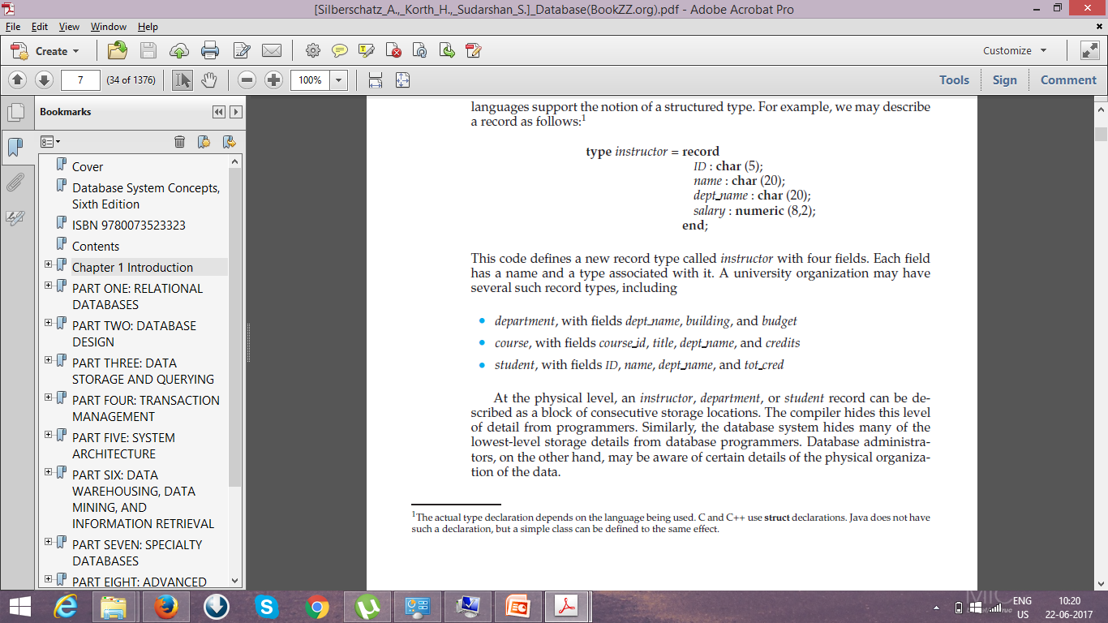
Example of university organization
Record –
    INSTRUCTOR with fields ID, NAME, DEPT_NAME, SALARY.
    DEPARTMENT with fields DEPT_NAME, BUILDING, BUDGET
    COURSE with fields COURSE_ID, TITLE, DEPT_NAME, CREDITS
    STUDENT with fields ID, NAME, DEPT_NAME, AND TOT_CRED

Slide 12
Instances and Schemas
Instances - collection of information stored in the database at a particular moment
Schema - The overall design of the database
  Logical Schema – the overall logical structure of the database
    Example: The database consists of information about a set of customers and accounts in a bank and their relationship
  Physical schema– the overall physical structure of the database
  Instance – the actual content of the database at a particular point in time
  Physical Data Independence – the ability to modify the physical schema without changing the logical schema
    Applications depend on the logical schema
    In general, the interfaces between the various levels and components should be well defined so that changes in some parts do not seriously influence others.

Slide 13
Example of university oraganization (cont)
In the physical level,
  an instructor, department, or student record - block of consecutive storage locations – KNOWN by Database Administrator.
  The compiler hides this level of detail from programmers.
In the logical level,
  each such record is described by a type definition and their interrelationship among record types.
  Programmers work at this level of abstraction using a programming language.
In the view level,
  Application programs that hide details of the data types from users.
  Several views of the database are defined, and a database user sees some or all of these views.

Slide 14
Data Models
Session 2

Slide 15
Outline
Data model
  Relational Model
  ER model
  Object based Data Model
  Semistructure Model
  Network Model
  Hierarchical Model
Database Language

Slide 16
Data Models
A collection of conceptual tools for describing
  Data
  Data relationships
  Data semantics
  Data constraints
Relational model
Entity-Relationship data model (mainly for database design)
Object-based data models (Object-oriented and Object-relational)
Semistructured data model (XML)
Other older models:
  Network model
  Hierarchical model

Slide 17
Relational model
Model uses a collection of tables to represent both data and the relationships among those data.
Each table has multiple columns and each column has a unique name.
The relational model is an example of a record-based model.
Record-based models are so named because the database is structured in fixed-format records
of several types.
Each table contains records of a particular type. Each record type defines a fixed number of fields, or attributes.
The columns of the table correspond to the attributes of the record type.
It is not hard to see how tables may be stored in files.
The relational model hides such low-level implementation details from database developers and users.
  Data Definition Language
  Data Manipulation Language
  Application Program

Slide 18
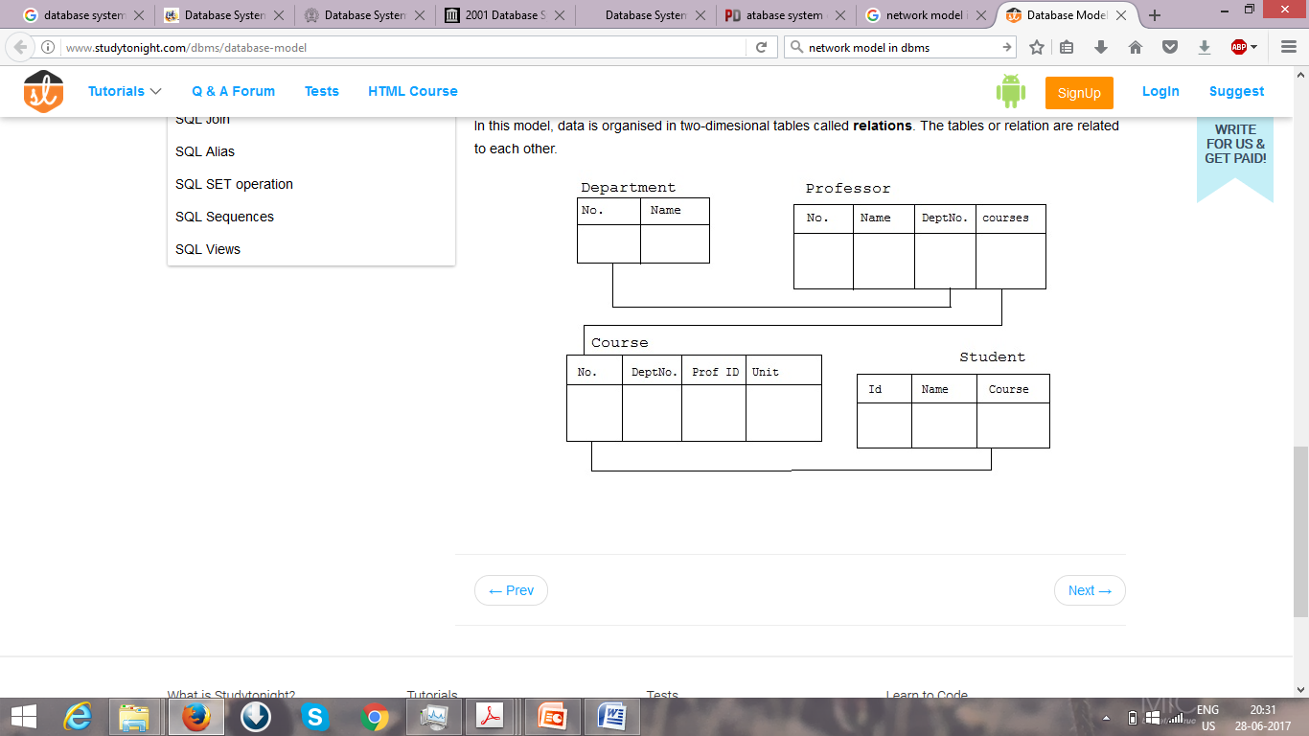
ENTITY-RELATIONSHIP MODEL
The entity-relationship (E-R) data model uses
  Entities - a collection of basic objects - “thing” or “object” in the real world
  Relationships among these objects.

Slide 19
OBJECT BASE DATA MODEL
Object-oriented programming (especially in Java, C++, or C#) has become the dominant software-development methodology.
Extending the E-R model
  Encapsulation,
  Methods (functions),
  Object identity.
Combines features of the object-oriented data model and relational data model.

Slide 20
SEMISTRUCTURED DATA MODEL
Specification of data where individual data items of the same type may have different sets of attributes.
Every data item of a particular type must have the same set of attributes.
The Extensible Markup Language (XML) is widely used to represent semistructured data.
  Defined by the WWW Consortium (W3C)
  Originally intended as a document markup language not a database language
  The ability to specify new tags, and to create nested tag structures made XML a great way to exchange data, not just documents
XML has become the basis for all new generation data interchange formats.
A wide variety of tools is available for parsing, browsing and querying XML documents/data

Slide 21
Hierarchical model
Hierarchical model is a data model which uses the tree as its basic structure.
A data structure diagram for a tree representing the STUDENT, FACULTY and CLASS.
The root node chosen is faculty, CLASS as a child of faculty and STUDENT as a child of class.
The cardinality between CLASS and FACULTY is one to many cardinality as a FACULTY teaches one or more CLASS.
The cardinality between a CLASS and a STUDENT is also one to many cardinality because a CLASS has many STUDENTS.

Slide 22
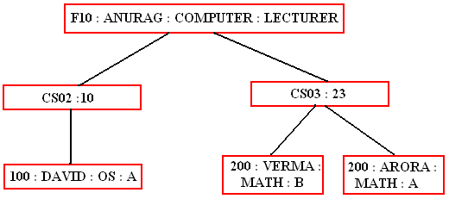
Hierarchical model

Slide 23
NETWORK MODEL
The Network model replaces the hierarchical tree with a graph thus allowing more general connections among the nodes.
The main difference of the network model from the hierarchical model, is its ability to handle many to many (N:N) relations. In other words, it allows a record to have more than one parent.
Suppose an professor works in department, courses and students.
The strict hierarchical arrangement is not possible here and the tree becomes a more generalized graph - a network.
The network model was evolved to specifically handle non-hierarchical relationships. As shown below data can belong to more than one parent. Note that there are lateral connections as well as top-down connections.
A network structure thus allows 1:1 (one: one), l: M (one: many), M: M (many: many) relationships among entities.

Slide 24
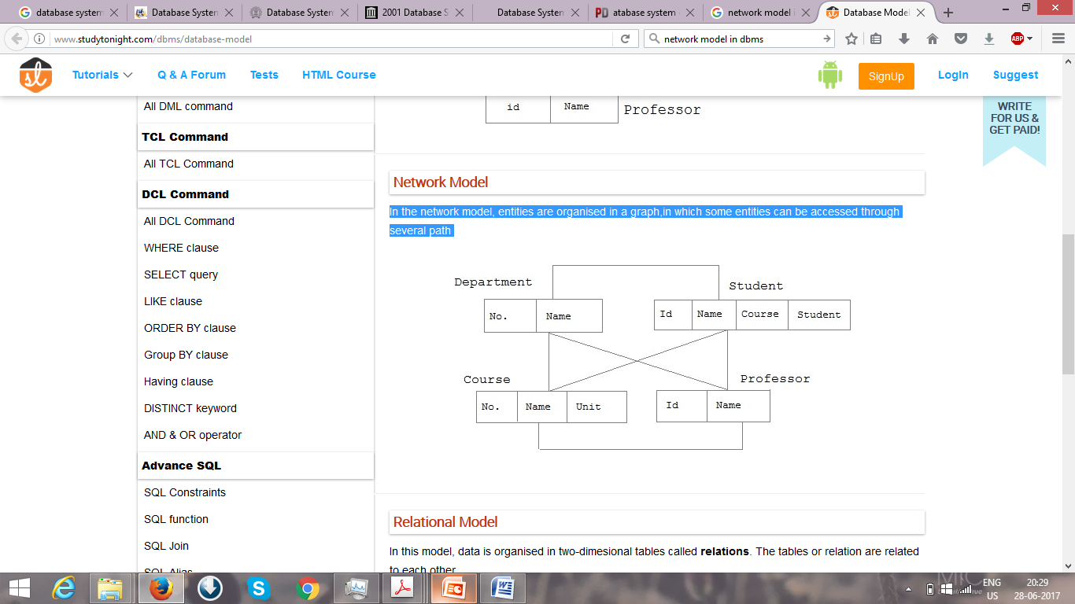
NETWORK MODEL

Slide 25
Database language
Session 3

Slide 26
DATABASE LANGUAGE
Data-Definition Lanaguage (DDL) – express database schema by a set of definitions.
For Instance,
Create table account (acc_no number(5), balance integer)
Data Dictionary or Data Directory – contains metadata (data about data).
DDL compiler generates a set of table templates stored in a data dictionary
Data dictionary contains metadata (i.e., data about data)
  Database schema
  Integrity constraints
    Primary key (ID uniquely identifies instructors)
  Authorization
    Who can access what
Data storage and definition Language – storage and access methods used by DB system by special type of DDL.

Slide 27
DataBASE Language Contd
DML - specify a database schema by a set of definitions
Language for accessing and manipulating the data organized by the appropriate data model
  Retrieval of information stored in the database
  Insertion of new information into the database
  Deletion of information from the database
  Modification of information stored in the database
Two classes of languages
  Procedural DMLs - a user to specify what data are needed and how to get those data.
  Declarative DMLs (nonprocedural DMLs) - a user to specify what data are needed without specifying how to get those data.

Slide 28
Database language contd
Database Access from Application Programs
  Programs that are used to interact with the database
  Host language – Cobol, C, C++, Java
  Two ways to do this
    Application program interface – used to send DML and DDL statements to the DB, retrieve the results
      Open Database Connectivity ODBC
      Java Database Connectivity JDBC
    Embed DML within the host language program – DML precompiler.

Slide 29

Database users and administrators

Slide 30
Database users and administrators contd
Goal – Retrieve information and store new information in DB.
Database users and User Interfaces
  Naive users - unsophisticated users - interact with the system through previously application programs.
  Application programmers - computer professionals write application programs to develop user interfaces
  Sophisticated users - interact with the system without writing programs - access using a database query language or data analysis software tools
  Specialized users - sophisticated users who write specialized database applications

Slide 31
Database users and administrators contd
Database Administrators
  Have central control of both the data and the programs - person who control over the system is called a database administrator (DBA).
Functions of a DBA
  Schema definition - DBA creates database schema by a set of data definition statements in the DDL.
  Storage structure and access-method definition.
  Schema and physical-organization modification -alter the physical organization to improve performance.
  Granting of authorization for data access - By granting different types of authorization, the database administrator can regulate which parts of the database various users can access.
  Routine maintenance. Examples of the database administrator’s routine maintenance activities are:
    Periodically backing up the database
    Ensuring that enough free disk space
    Monitoring jobs running on the database
    Ensuring that performance

Slide 32
Database architecture database system structure
Session 4

Slide 33
Outling
Database Architecture
Database System Structure
History of Database

Slide 34

Database Architecture

Slide 35
Storage Management
Storage manager is a program module that provides the interface between the low-level data stored in the database and the application programs and queries submitted to the system.
The storage manager is responsible to the following tasks:
  Interaction with the OS file manager
  Efficient storing, retrieving and updating of data
Issues:
  Storage access
  File organization
  Indexing and hashing

Slide 36
Storage manage
The storage manager components include:
  Authorization and integrity manager – tests integrity constraints and checks the authority of users to access data.
  Transaction manager, ensures DB in a consistent state even in system failures and in concurrent transaction executions
  File manager - manages disk storage and the data structures
  Buffer manager – fetch data from disk storage into main memory
Data Structures Implemented
  Data files - store the database itself.
  Data dictionary -stores metadata about the structure of the database,
  Indices – provide fast access to data items

Slide 37

Query Processing
1. Parsing and translation
2. Optimization
3. Evaluation

Slide 38
Query Processing (Cont.)
Alternative ways of evaluating a given query
  Equivalent expressions
  Different algorithms for each operation
Cost difference between a good and a bad way of evaluating a query can be enormous
Need to estimate the cost of operations
  Depends critically on statistical information about relations which the database must maintain
  Need to estimate statistics for intermediate results to compute cost of complex expressions

Slide 39
Transaction Management
What if the system fails?
What if more than one user is concurrently updating the same data?
A transaction is a collection of operations that performs a single logical function in a database application
Transaction-management component ensures that the database remains in a consistent (correct) state despite system failures (e.g., power failures and operating system crashes) and transaction failures.
Concurrency-control manager controls the interaction among the concurrent transactions, to ensure the consistency of the database.

Slide 40
Database Architecture
The architecture of a database systems is greatly influenced by
the underlying computer system on which the database is running:
Centralized
Client-server
Parallel (multi-processor)
Distributed

Slide 41
Database system structure
Database systems can be centralized, or client-server, where one server machine executes work on behalf of multiple client machines.
Database systems can also be designed to exploit parallel computer architectures. Distributed databases span multiple geographically separated machines.
  Structure of Modern Computer System.
  Query processing using parallel processing
  Distributed Database
  Ensure atomicity & concurrency control of transactions that execute at multiple sites
  Distributed query processing and directory systems
Database applications are usually partitioned into two or three parts,
  Two-tier architecture, the application resides at the client machine,
  Three-tier architecture, the client machine acts as front end and no direct database calls.

Slide 42
History of Database Systems
1950s and early 1960s:
  Data processing using magnetic tapes for storage
    Tapes provided only sequential access
  Punched cards for input
Late 1960s and 1970s:
  Hard disks allowed direct access to data
  Network and hierarchical data models in widespread use
  Ted Codd defines the relational data model
    Would win the ACM Turing Award for this work
    IBM Research begins System R prototype
    UC Berkeley begins Ingres prototype
  High-performance (for the era) transaction processing

Slide 43
History (cont.)
1980s:
  Research relational prototypes evolve into commercial systems
    SQL becomes industrial standard
  Parallel and distributed database systems
  Object-oriented database systems
1990s:
  Large decision support and data-mining applications
  Large multi-terabyte data warehouses
  Emergence of Web commerce
Early 2000s:
  XML and XQuery standards
  Automated database administration
Later 2000s:
  Giant data storage systems
    Google BigTable, Yahoo PNuts, Amazon, ..

Slide 44
Entity relationship model
Session 5

Slide 45
outline
ER model
Entity Sets
Attribute Type
Relationship Sets
Constraints
Keys

Slide 46
Entity relationship model
Represents the logical structure of DB, serve as semantic data model
Useful in mapping the meaning and interactions of real world onto conceptual schema.
Basic concepts
  Entity Sets
  Relationship sets
  Constraints
  Keys

Slide 47
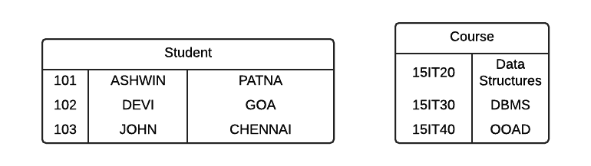
Entity sets
Entity: A thing or object in real world.
  Ex: Each student in a department is an entity.
  Stud Id= 101 identify a unique person in the department.
Entity Set: set of entities of same type.
  Ex: set of all student details - student entity set.
Attributes: descriptive properties possessed by each member of entity set
  Ex: Stud_id, Stud_name, City
101 is value of the attribute Stud_id
Domain / Value set: set of permitted values for each attributes.
  Ex: Stud_name is set of all strings of certain length

Slide 48
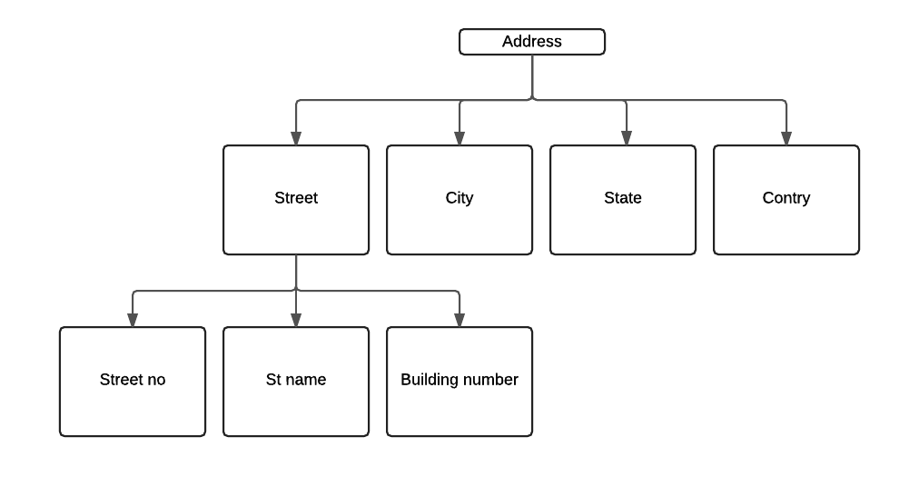
Attribute types
Simple attribute – attributes cant be divided into subparts.
  Ex: Firstname, MiddleName, LastName of students
Composite attribute – attributes can be divided into subparts
  Ex: StudName can be divided into Firstname, LastName
Single-valued attribute – have single value for particular entity
  Ex: StudId
Multivalued attribute – can have more than single value for a particular entity
  Ex: StudPhoneNo.
Derived attribute – value can be derived from value of other related attribute
  Ex: Value of Age attribute can be derived from DOB attribute

Slide 49
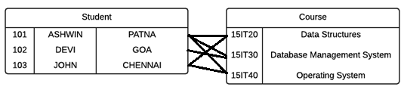
Relationship sets
Relationship : association among entities.
  Ex: Relation between Devi and DBMS.
Relationship set: set of relationships of same type.
  Ex Relationship set Coursestaken
Relationship Instance: association between entities that is modeled
  Ex: 101 from Goa taken DBMS.
Descriptive Attribute – attribute of relationship set
  Ex: DateofEnrollment in relationship set Coursestaken
Participate: An entity E1,E2 ..En Participate in Relationship set R.
Entity Role: Function that entity plays in relationship
Recursive Relationship set
Binary Relationship set

Slide 50
Constraints
Mapping Cardinalities
  One to One
  One to Many
  Many to One
  Many to Many
Participation Constraints
  Total
  Partial

Slide 51
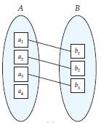

Constraints
1:1 1:M M:1 M:M
B Total with A
A Partial with B

Slide 52
keys
Keys – used to identify a set of attributes that can identify entities from each others.
Entity sets
Super Key: set of one or more attributes (collectively) identify uniquely an entity in entity set. Ex: <StudId>, <StudName,DOB>, <StudId,City>, <StudId, City, State>
Candidate keys: a superkey which has no propersubset or minimal superkey. Ex: StudId
Primary Key: DB designer uses a candidate key for identification of entity uniquiely. Ex: StudId
Relationship sets
Relationship sets contains Primary key of all entity set involves in relationship

Slide 53
End of Unit 1
Session 5

